Slide 1
Medical Diagnosis AID
Predicting diabetes likelihood from clinical data

Slide 2
Let’s Explore Together!
Dataset and the challenge
EDA and preprocessing
Models and results
Demo MVP

Slide 3
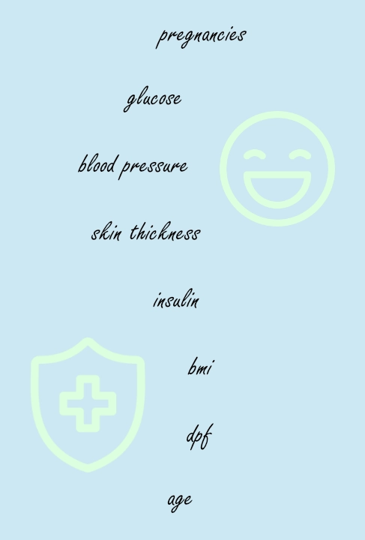
Dataset: PIMA Indians Diabetes Database Task: Binary Classification Target: Outcome 768 rows, 8 input features, 1 target
Dataset and the challenge

Slide 4

Exploratory Data Analysis and preprocessing
The dataset was inspected before training.
Some zero values were medically improbable, so they were replaced with NaN and then imputed with the median.
Not every zero was treated as missing: for example, pregnancies = 0 is valid.

Slide 5
Models and results
Model | Accuracy | Precision | Recall | F1-score*
Logistic Regression | 0.701 | 0.587 | 0.500 | 0.540
Random Forest Cl. | 0.779 | 0.727 | 0.593 | 0.653
Logistic Regression was used as a baseline model.
RandomForestClassifier was chosen as the final model because it performed better on the test set across all main metrics.
F1-score* is a metric that balances precision and recall.

Slide 6
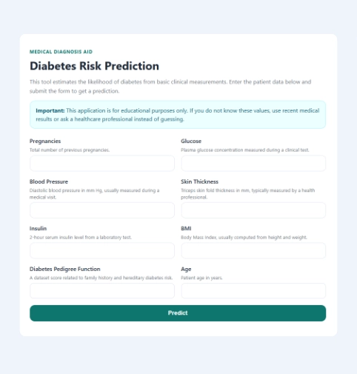
Demo MVP
Flask web app with HTML form
Prediction result page
JSON API route
Docker support

Slide 7
Let’s Take off Together!
Simple project, but fully end-to-end.
Tailor-made with love to be Understandable, Reproducible and Defendable.
Giulio Mazzanti #690979 AU 25-26 g.mazzanti12@studenti.unipi.it

